Slide 1
MIS 321
SOLID Design Principles
Fall - 2020

Slide 2
SOLID Design Principles
5 principles of OO Design
Introduced by Robert Martin (Uncle Bob)
Frequently referenced in design pattern literature
Named my Michael Feathers

Slide 3
SOLID – Why do we need it?
Make code more maintainable
Make code easier to extend with new functionality without breaking existing functionality
Make code easier to read, reducing ramp up time, providing more time to develop actual solutions
Makes code more testable.
WARNING… These are principles, not rules. Use common sense….

Slide 4
SOLID
S
O
L
I
D
SRP
OCP
LSP
ISP
DIP
Single Responsibility Principle
Open/Closed Principle
Liskovs Substitution Principle
Interface Segregation Principle
Dependency Inversion Principle

Slide 5
SOLID Design Principles – Single Responsibility
A class should have one, and only one, reason to change.
There is a place for everything and everything is in its place…. Uncle Bob…. Ben Franklin
Find one reason to change and take everything else out of the class
Very small classes with precise names > Large classes with generic names

Slide 6
Single Responsibility Example
A class that keeps up with books
The same class keeps up with saving to a file
The same class loads data from a file
The same class loads data from a url
This would violate the Single Responsibility principle.

Slide 7
SOLID – Open / Closed Principle
Software entities should be open for extension but closed for modification
Extend functionality by adding new code instead of changing existing code
Separate behaviors so the system can easily be extended and not broken
Overriding goal is to never break the core system as you add new functionality!

Slide 8
Open / Closed Principle - Example
A SalaryCalculator class that takes in a list of developers with Level, Hourly Rate, and HoursWorked
Method in the class returns total salary for all developers relying on an instance method to calc individual salaries
Management wants to give junior devs a bonus. Can we accomplish this without changing the Salary Calculator class????

Slide 9
Liskov Substitution Principle
A subclass should behave in such a way that it will not cause problems when used instead of the superclass.
Derived class should be able to substitute its parent class without the consumer knowing it.
Every class that implements an interface, must be able to substitute any reference throughout the code that implements that same interface
Every part of the code should get the expected result no matter what instance of a class you send to it, given it implements the same interface

Slide 10
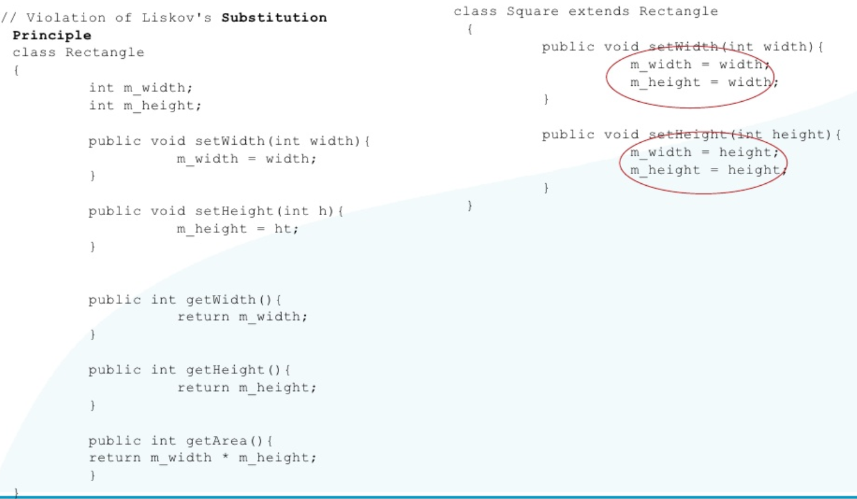
Liskov Substitution Principle

Slide 11
Interface Segregation Principle
Clients should not be forced to depend upon interfaces that they don’t use.
“who cares if a client gets a bit more than it needs. It can just ignore it…..” - Made up developer
Instead, break down interfaces into smaller pieces to make them easier to implement and offering more control over who sees what.

Slide 12
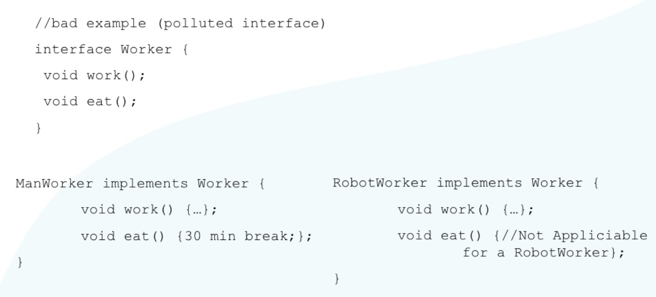
Interface Segregation Principle

Slide 13
Dependency Inversion Principle
A) High-level modules should not depend on low-level modules. Both should depend on abstractions.
B) Abstractions should not depend upon details. Details should depend upon abstractions.
Ensuring classes don’t depend on specific implementations, it becomes easy to change things around…….

Slide 14
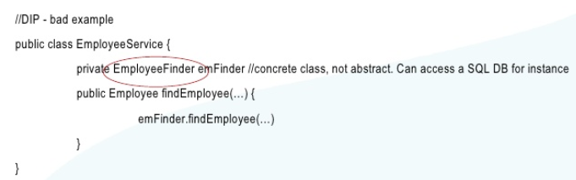
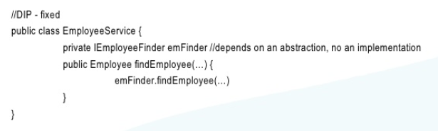
Dependency Inversion Principle

